Slide 1



VOIS Innovation
Marathon 2.0

Slide 2
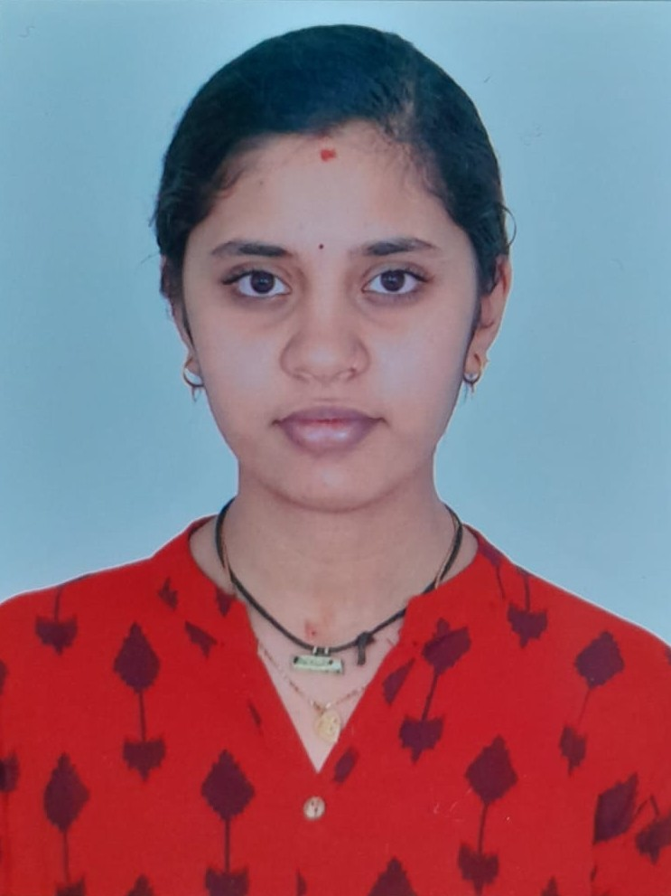



PROJECT TITLE: Real-Time Detection of Sybil & Sensor Spoofing Attacks in Connected Autonomous Vehicles
Team No.47
SWATHI.M.
ECE
Insert your professional photo
JSS Academy Of Technical Education Bangalore (JSSATEB)
SANDHYA.J
ECE
SURABHI.R.
ECE

Slide 3

PROBLEM STATEMENT
Connected and Autonomous Vehicles (CAVs) depend on Vehicle to Vehicle(V2V) and
Vehicle to Infrastructure (V2I) communication for safe, efficient transportation.
These networks are vulnerable to Sybil attacks , Sensor spoofing ,GPS spoofing and many other attacks causing misinterpretation in V2V and V2I communication , unsafe routing and also accidents due to unsafe decision taken by CAVs during attack.
Current security solutions lack real-time detection and monitoring, limiting the ability to respond promptly and thus there is a need for an intelligent , real-time detection system to handle this ensuring safe and secure transportation.

Slide 4

NEED OF PROJECT
Why Needed:
Sybil attacks malicious vehicles create multiple fake identities, causing false traffic information, unsafe routing, and potential accidents thus undermining trust in V2V/V2I communication
Sensor spoofing compromises perception and decision-making in autonomous driving.
Existing methods are computationally heavy, partial, and not suitable for real-time deployment.
Goal:
Develop a lightweight ML-based framework to detect both attacks simultaneously.

Slide 5

PROPOSED SOLUTION
Solution:
ML-driven real-time detection system for Sybil & Sensor Spoofing attacks.
Approach:
SUMO simulator generates traffic traces.
Python preprocessing extracts mobility + sensor features.
Random Forest model classifies malicious identities and spoofed sensor data.
Real-time pipeline with alerting + dashboard visualization.

Slide 6

SOLUTION OVERVIEW
Pipeline:
Data generation (mobility + sensor traces)
Feature extraction (identity anomalies + sensor inconsistencies)
ML classification (Random Forest)
Real-time alerts + dashboard visualization
Outcome:
Low-latency detection of both Sybil and sensor spoofing attacks.

Slide 7


TECHNOLOGY USED
1
Simulator: SUMO (mobility traces)
2
ML Model: Random Forest
3
Web Dashboard Technologies
4
Python
5
Fast API , Render (Backend), Vercel (Frontend)
5

Slide 8

TECHNICAL FLOW DIAGRAM
DATA GENERATION LAYER
PYTHON PROCESSING PIPELINE
RANDOM FOREST CLASSIFIER
VISUALIZATION AND ALERTS
Sumo Traffic Simulator
Data Ingestion & Cleaning
Model Training & Prediction
Threat Watch Web Dashboard
z
Mobility Trace Generation(csv)
Feature Extraction (Pos, Vel, Acc )
Benign vs. Legitimate Labeling
Real-time Security Notifications

Slide 9

ARCHITECTURE BLUEPRINT
Presentation Layer
(UI for analysis and visualization)
Business Layer
(End User,Fleet operators)
Service Layer
(Detection System,Risk Assesment,Threat Advisor)
Backend Layer
(Data Access and Analysis)

Slide 10
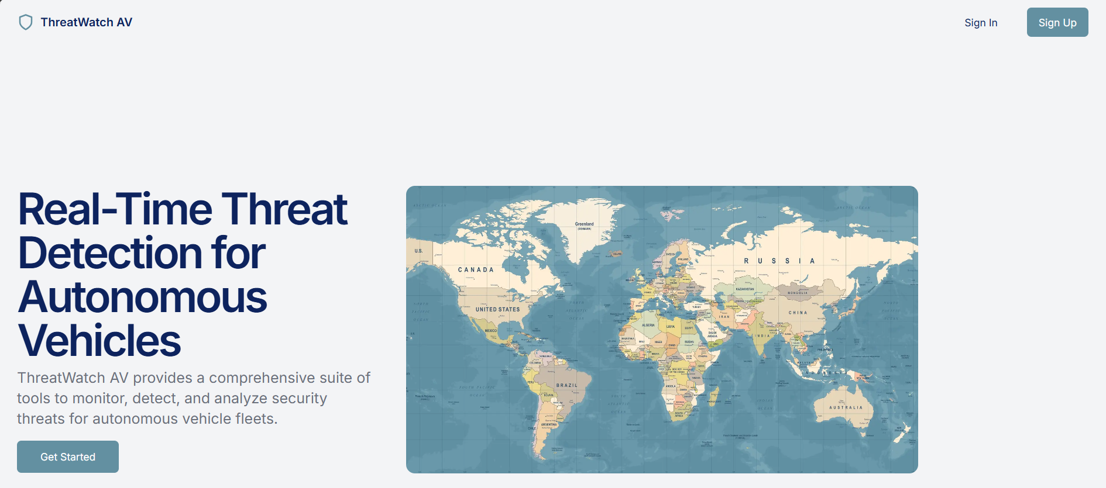
SCREEN SHOTS OF THE PROJECT

Slide 11
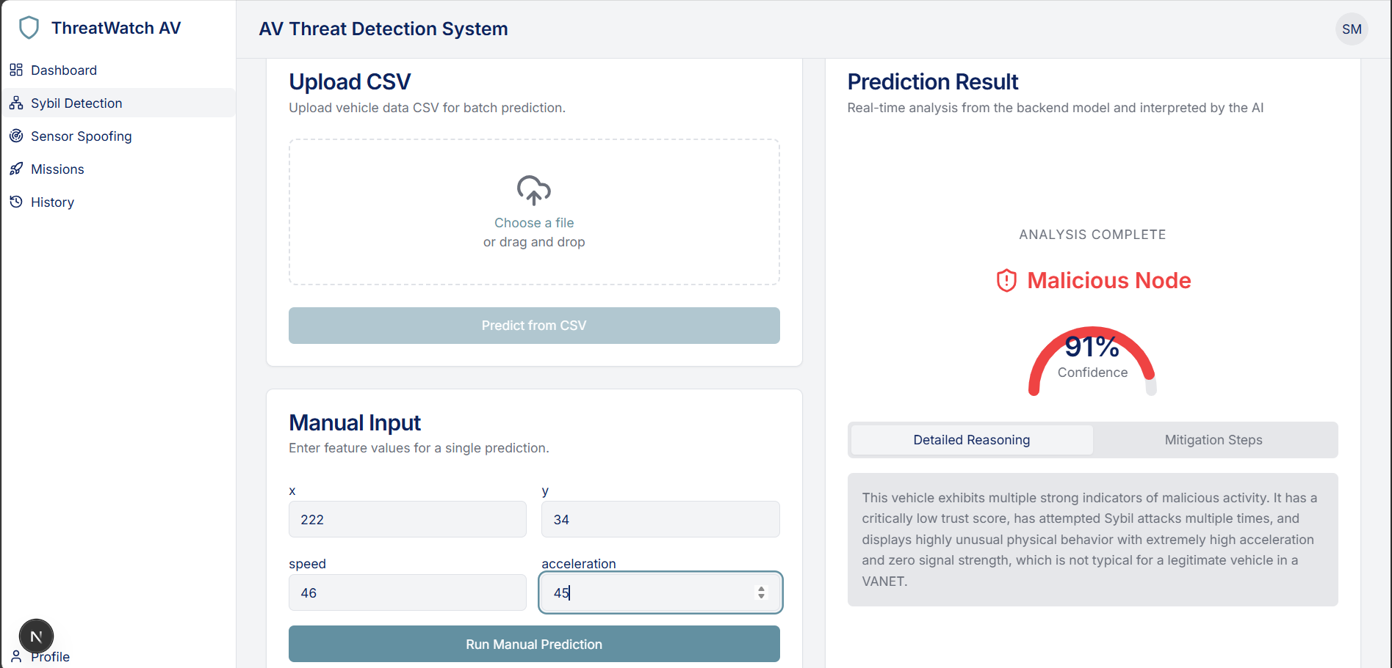
Screen shots of your project -

Slide 12
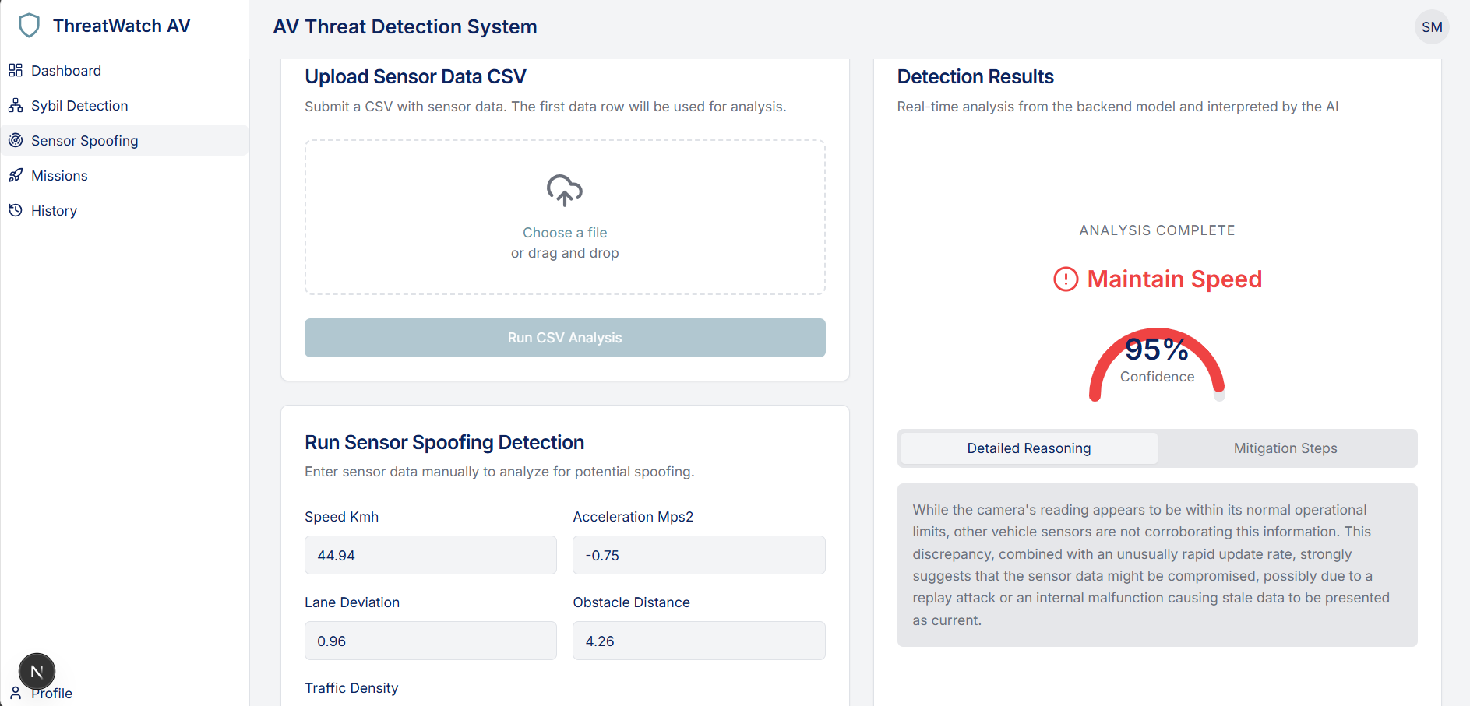

Slide 13
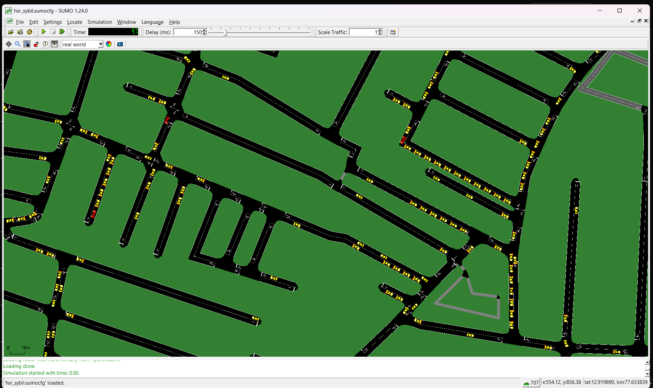

Slide 14

ROLE OF AGENTIC AI AND GEN AI IN THE SOLUTION
Gen AI translates those raw numerical features into human-readable reasoning and actionable mitigation steps for the analyst.
It powers the AI Risk Assessment on the dashboard, looking at the volume of both Sybil and Sensor alerts simultaneously to generate a prioritized, high-level summary of the fleet's current security posture.
Agentic AI: The Threat Advisor acts as an agent that can "observe" the live status of the dashboard and "reason" over that data to provide situational guidance tailored to the specific threats detected.
It maintains a memory of the conversation and the real-time threat context (e.g., active Sybil alerts), allowing it to behave as an autonomous security assistant that guides the user through complex response protocols step-by-step.

Slide 15
Novelty and Uniqueness
1
2
3
4
Rapid Response System
Provides 3 - 5 technical mitigation steps which is attack specific.
AI Threat Advisor
Offers live strategic guidance and provides understanding about the attack to the user.
AI Risk Assessment
Reduced burden on fleet managers allowing to focus on critical scenarios
Reasoning with AI.
Logical explanation behind threat detection

Slide 16
GIT HUB LINK
Please create public GitHub repository (Enable Add README button while creating repository)
with format:
Please test and Paste the working GitHub URL –
Make sure you have Uploaded following three files into your github repository
1. app.py file ,
2. your_hackthon_problemstatement.pdf file
3. your projectpresntation.pptx file

Slide 17

FUTURE SCOPE
Implement collaborative learning with other attack detection
Integrate with advanced simulation OMNeT++ and Veins
Deployment on cloud native architecture for large scale computation

Slide 18
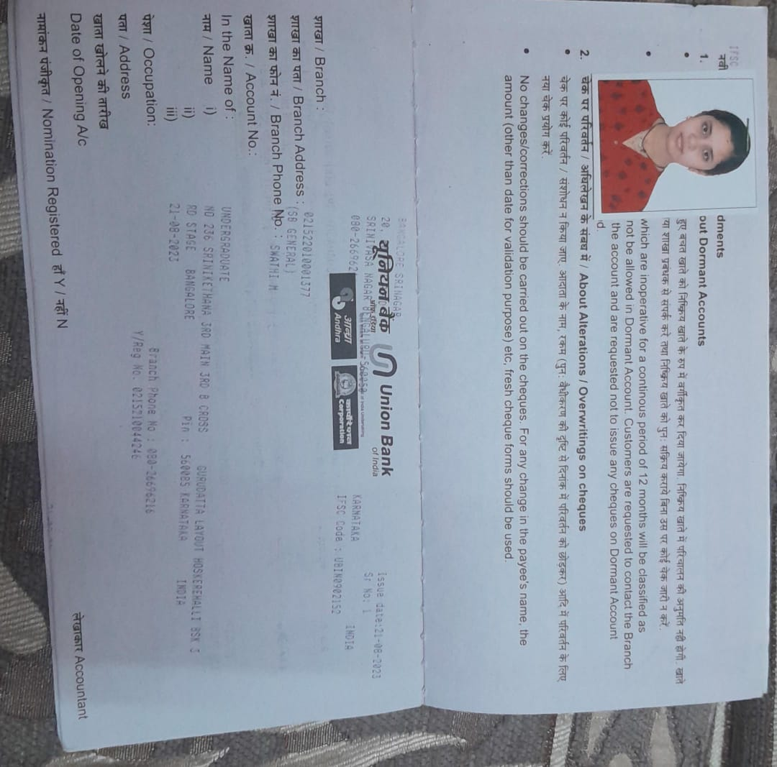
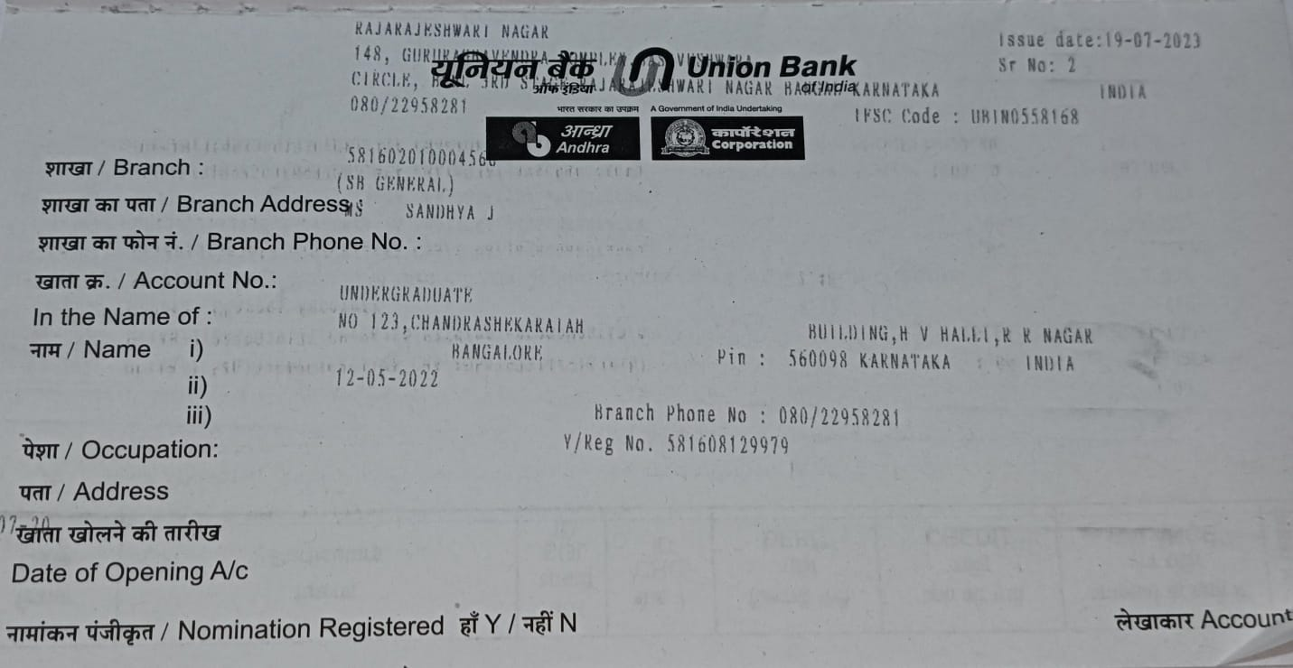
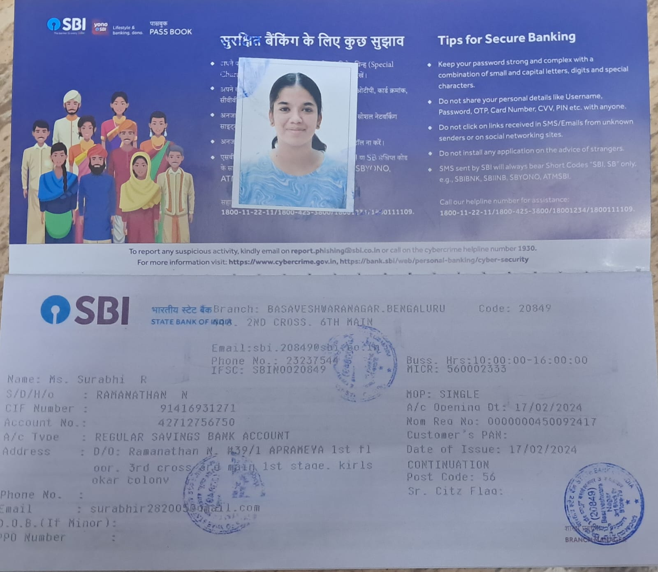
BANK DETAILS
Full Name (as per bank records): | Bank Name | Branch Name | Account Number | Account Type (Savings / Current) | IFSC Code
Swathi M | Union Bank of India | Bangalore Srinagar Branch | 021522010001377 | Savings | UBIN0902152
Sandhya J | Union Bank of India | Rajarajeshwari Nagar branch, Bengaluru | 581602010004566 | Savings | UBIN0558168
Surabhi R | State Bank of India | Basaveshwaranagar,Bengaluru | 42712756750 | Savings | SBIN0020849
Insert photo of passbook / bank statement
Insert photo of passbook / bank statement
Insert photo of passbook / bank statement
SWATHI M
SANDHYA J
SURABHI R

Slide 19
THANK YOU!

